Slide 1
Design and Analysis of Algorithms Assignment 2
IIT2019030 Kaushal Kumar
IIT2019031 Sarvesh
IIT2019032 Aarushi

Slide 2
Contents
Problem Statement
Introduction
Application
Algorithm Design
Pseudo Code
Code
Complexity Analysis
Time Complexity
Space Complexity
Experimental Study

Slide 3
Problem Statement
Prepare a matrix of random characters of size 50×50 and check
for valid English words diagonally.

Slide 4
Introduction
According to the given problem statement, we had to check if any word in the diagonals are valid or not, therefore we have made use of PyEnchant library from python.
Enchant is used to check the spelling of words and suggest corrections for words that are misspelled. It can use many popular spell checking packages to perform this task, including Ispell, Aspell andMySpell.
It is quite flexible at handling multiple dictionaries and multiple languages. Dictionaries are created using a language tag which specifies the language to be checked. The language tag used here signifies American English.
If the language tag is not specified, an attempt is made to determine the language currently in use. This is not always possible, in which case an Error is raised.

Slide 5
Application
Python’s great library system made it easier to check for valid English words available in the diagonal of the randomly generated matrix.
PyEnchant is a spell checking library for Python, based on the excellent Enchant library.It combines all the functionality of the underlying Enchant library with the flexibility of Python and a nice“Pythonic” object-oriented interface.
Used mainly for dictionary related purposes, and spelling checking domains or other work related to that.

Slide 6
Algorithm Design
Our algorithm iterates the elements and check if it is present on the main diagonal then push it on the string.
Then we are checking whether the string is present in the dictionary or not with the help of en-chant library.
If the string is present the it append to the array of string and in last it print all the strings which is present in the dictionary.
Running through the matrix it searches for valid words along the diagonal, as mentioned in the above figure.This algorithm runs for each column of the matrix hence takes 50x50 time.

Slide 7
Pseudo Code
d=enchant.Dict(”enUS”)
rows, cols = (50, 50)
arr= []
for i in range(cols):
col= []
for j in range(rows):
col.append(randomcharacter)
arr.append(col)
ans= []
for i in range(0,cols):
s= ””
for j in range(i,rows):
s+ =arr[j][j]
if(len(s) == 1 and s.upper() != ’A’):
continue
if(d.check(s)):
ans.append(s)
print(ans)

Slide 8
Code
import string
import random
import enchant
d = enchant.Dict("en_IN")
rows, cols = (50, 50)
arr = []
for i in range(cols):
col = []
for j in range(rows):
col.append(random.choice(string.ascii_letters))
arr.append(col)
ans = []
for i in range(0,cols):
s = ""
for j in range(i,rows):
s+=arr[j][j]
if(len(s) == 1 and s.upper() != 'A'):
continue
if(d.check(s)):
ans.append(s)
print(ans)

Slide 9
Complexity Analysis
Time complexity
In case of time complexity the loops are running completely through the entire fixed matrix for twice. So, after accordingly analysing the pseudo code we can infer that time complexity will be the size of matrix.
So Time Complexity of the Algorithm = O(n²).
Space Complexity
As the size for the matrix is fixed according to the problem statement thus,the space used by any of the algorithm will be constant and equal to that fixedvalue. Here the space complexity is 50x50.
More, generally we can say that space complexity of the algorithm is O(n²)

Slide 10
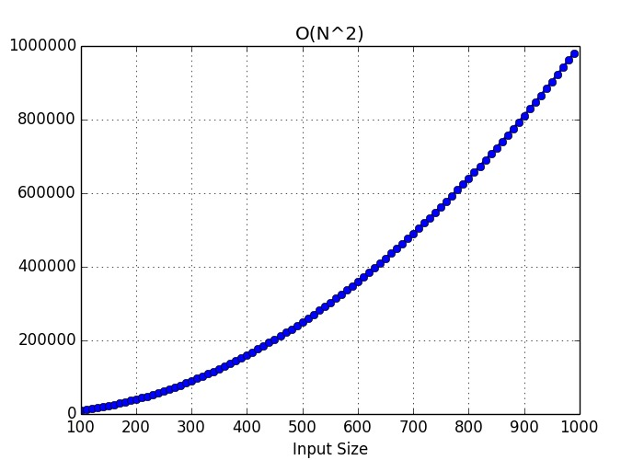
Experimental Study
Apriori Analysis:
Apriori analysis means,analysis is performed prior to running it on a specific system.This analysis is a stage where a function is defined using some theoretical model.Hence,we determine the time and space complexity of an algorithm by just looking at the algorithm rather than running it on a particular system with a different memory,processor, and compiler.So,as we discussed under the heading complexity analysis we arrived at the conclusion that time complexity is O(n²).

Slide 11
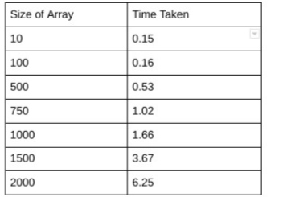
Aposteriori Analysis:
Aposteriori analysis of an algorithm means we perform analysis of an algorithm only after running it on a system.It directly depends on the system and changes from system to system.So, for the a aposteriori analysis of the algorithm,we have run our code on the compiler and get values of the time by specifying the value of n and m and different value of the time had occur.
Table for the Aposteriori Analysis

Slide 12
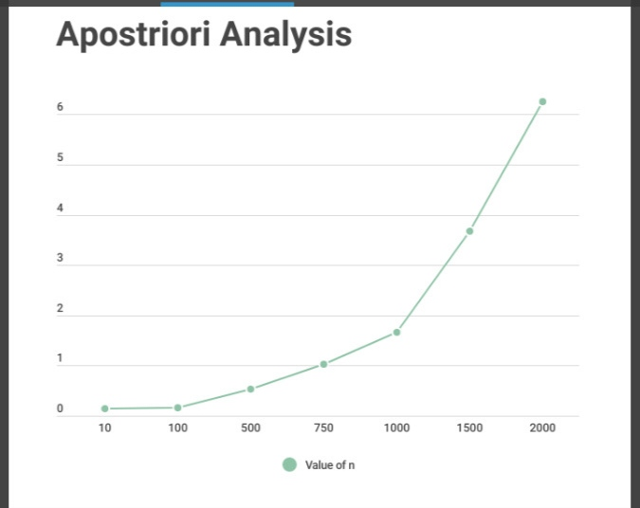

Slide 13
References
https://pyenchant.github.io/pyenchant/tutorial.html
https://pypi.org/project/pyenchant/

Slide 14
THANK YOU

